Slide 1
Minor Project Mid-Term Presentation
Plant Disease detection using Deep Learning and image processing
By:-
Shivansh Syal (199301241)
Sarthak Ahuja(199301246)

Slide 2
Gantt Chart
 |  | Months
 |  | January | February |  | March |  | April |  | May
 | Schedule for Project Work | 15-30 | 1 - 15 | 15 - 30 | 1-15 | 15-30 | 1-15 | 15-30 | 1-15 | 15-30
1 | Initial Research
2 | Synopsis submission
3 | Setting up basic requirements
4 | Image pre-processing
5 | Preparing a trainable dataset
6 | Mid Term Presentation
7 | Develop the web application
8 | Using Model on test dataset
9 | Project Report
10 | Final Presentation

Slide 3
Introduction
The latest generation of convolutional neural networks (CNNs) has achieved impressive results in the field of image classification. By the means of this minor project, we aim to classify the plant diseases by assessing the images of the leaves with the application of Deep learning and image processing and finding the most optimal machine learning algorithm to achieve the same, and create an interface to classify the provided image and generate the appropriate results using the model which may include various types of disease and their respective treatments.
Plant diseases have turned into a major problem as it can cause significant reduction and losses in both quality and quantity of agricultural products.A vast majority of the growing national population depends on agriculture yields. Farmers have wide range of diversity to select suitable fruit or vegetable crops to grow. But the cultivation of these crops for optimum yield and quality produce is highly technical & challenging. It can be improved by the aid of technological support and mechanized farming.

Slide 4
Introduction (contd.)
The need for agricultural practice advancement is growing every day, and it's one of those fields that gets overlooked when it comes to the use of technology and artificial intelligence, which are ubiquitous in many aspects of our daily lives, but we're still using decades-old practices in agriculture, which has a significant impact on our agrarian economy. Machine learning can offer farmers with more detailed information on their crops, allowing them to make better agricultural decisions.
This applications could be used as a foundation for developing expert assistance or automated screening systems. Such tools may help to promote more sustainable agriculture practices and increase food security.

Slide 5
Project Objective
Using the plant village dataset as the train and test data, the goal of this project is to develop the best possible machine learning model to classify and identify the effective area of a diseased plant leaf plant disease by combining various image processing techniques with certain supervised or unsupervised machine learning algorithms, whichever produces the best accuracy and build a usable interface for providing disease related information and its treatments. This will be a critical step in recognizing the disease, its stage, the appropriate insecticide, pesticide, or fertilizer, and the appropriate dosage, as well as establishing a link between disease behavior and finding a solution for it and build a usable interface for providing disease related information and its treatments.

Slide 6
Project Objective (contd.)
Current Practice | Pros | Cons
Manual selection of fertilizer/insecticide/pesticide and its amount without any automated recommendations or any other expertise. | Farmers determine the most appropriate amount based on the disease to the best of their knowledge. | Non-automated time-consuming process. Can lead to excessive usage, crops harmful for consumption, soil and water pollution.
Manual disease detection and diagnosis by farmer farmers or by agricultural scientists | A decision is made based on visuals and the spread to the best of farmer’s knowledge. | Can be inaccurate and inefficient at times due to human error or lack of knowledge this is a very challenging and time-consuming task.
Automatic disease detection with the help of machine learning algorithm. | It is more accurate than the traditional practices | use a very high number of training parameters. Consequently, the training time and the prediction time of these systems are very high, or they require a machine with high computation powers and are not available to all farmers

Slide 7
Methodology
The steps to be followed to achieve the objective of this project are as follows:
Datasets -The leaf images of peach plants have been extracted from the Plant Village dataset. The datasets image data for many plant leaves diseases and each of them has a healthy class contains many leaf images, and the diseased (Bacterial Spot) class comprise of diseased leaf images.
Image processing and labelling-Images intended to be used as datasets for deep neural network classifiers are to be preprocessed. Preprocessing may involves cropping all the images, in order to highlight the region of interest, and using CV2, adjusting the size and colors of the image and making more changes according to the dataset.
.

Slide 8
Methodology (contd.)
Augmentation Process-The main purpose of applying augmentation is to increase the dataset and introduce slight distortion to the images which helps in reducing overfitting during the training stage. The image augmentation contained one of several transformation techniques including affine transformation, perspective transformation, and simple image rotations. Affine transformations were applied to express translations and rotations (linear transformations and vector addition, resp.) where all parallel lines in the original image are still parallel in the output image.
Neural Network Training-To train the model, the leaf images of plants will be randomly divided such that 70% of them form the training dataset, and 30% form the testing dataset. In order to get better feature extraction, final images intended to be used as dataset for deep neural network classifier were preprocessed in order to gain consistency. Procedure of image preprocessing involved cropping of all the images manually, making the square around the region of interest (plant leaves). Images with smaller resolution and dimension less than 500 px were not considered as valid images for the dataset.

Slide 9
Methodology (contd.)
Web Application - Will be using react with redux to develop the front-end of the application where a user can upload the image of the plant (or use the camera), which is then processed by the developed model to find out any disease in the plant, and as a result, return the ailments and treatment of the unhealthy plant. We’ll be using firebase as the backend service provider and use its hosting, cloud storage and firestore SDKs

Slide 10
Screenshots
Here are some of the screenshots of the Web application of our project so far:

Slide 11
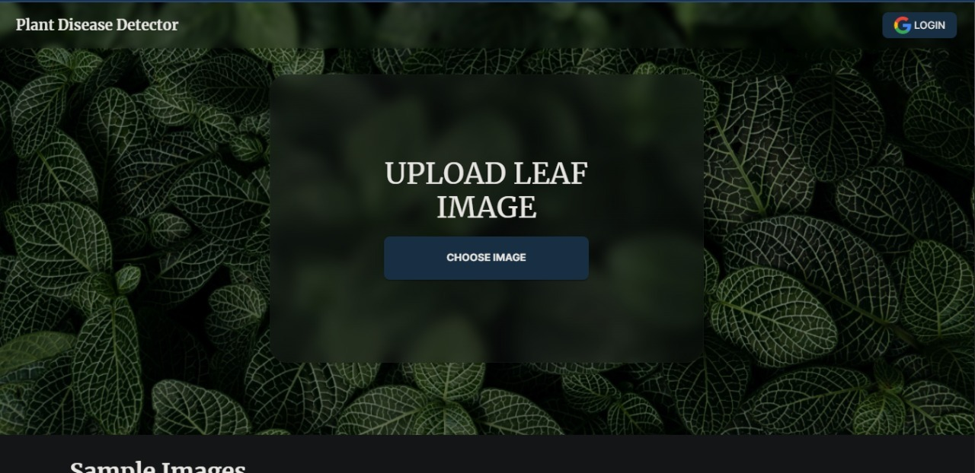
Screenshots (contd.)

Slide 12
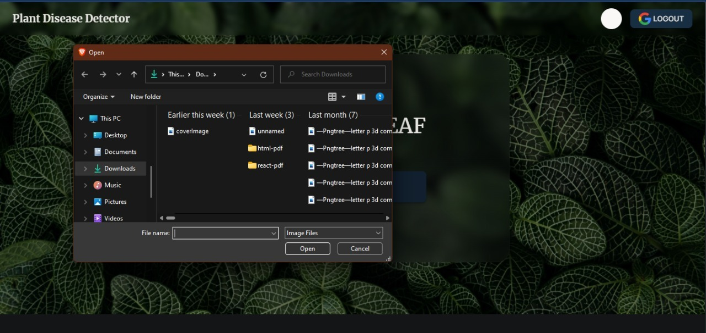
Screenshots (contd.)

Slide 13
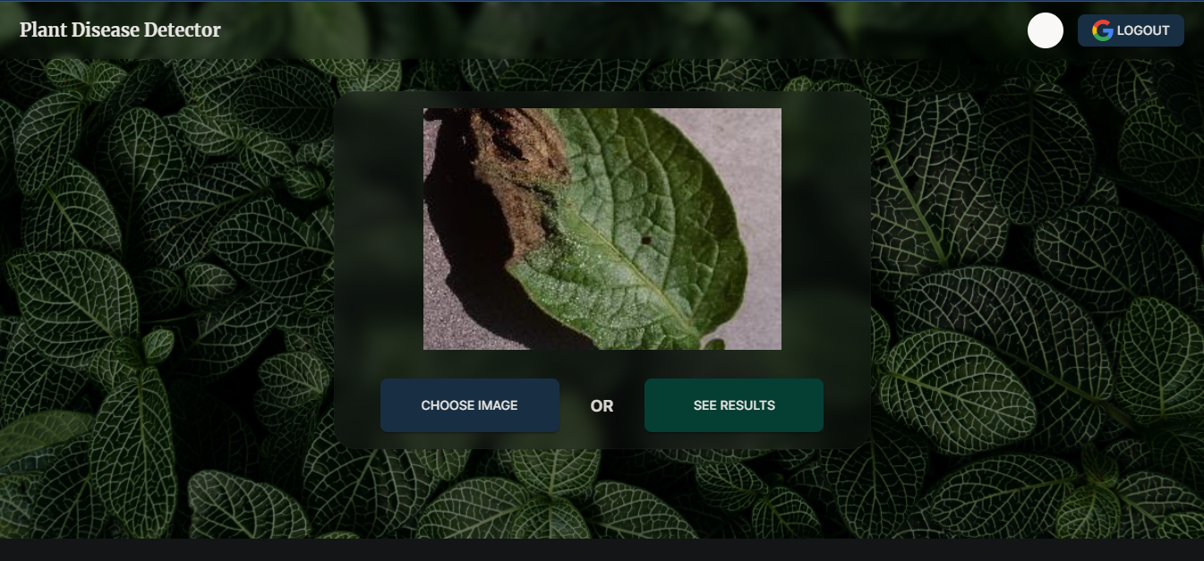
Screenshots (contd.)

Slide 14
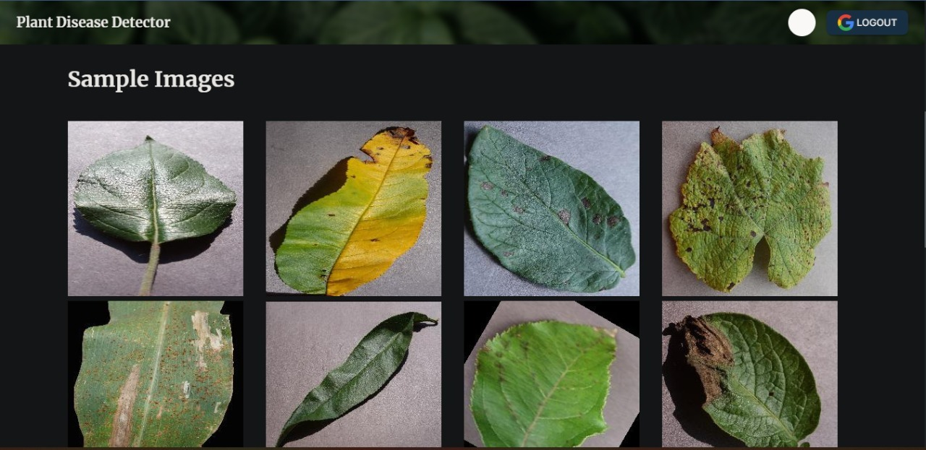
Screenshots (contd.)

Slide 15
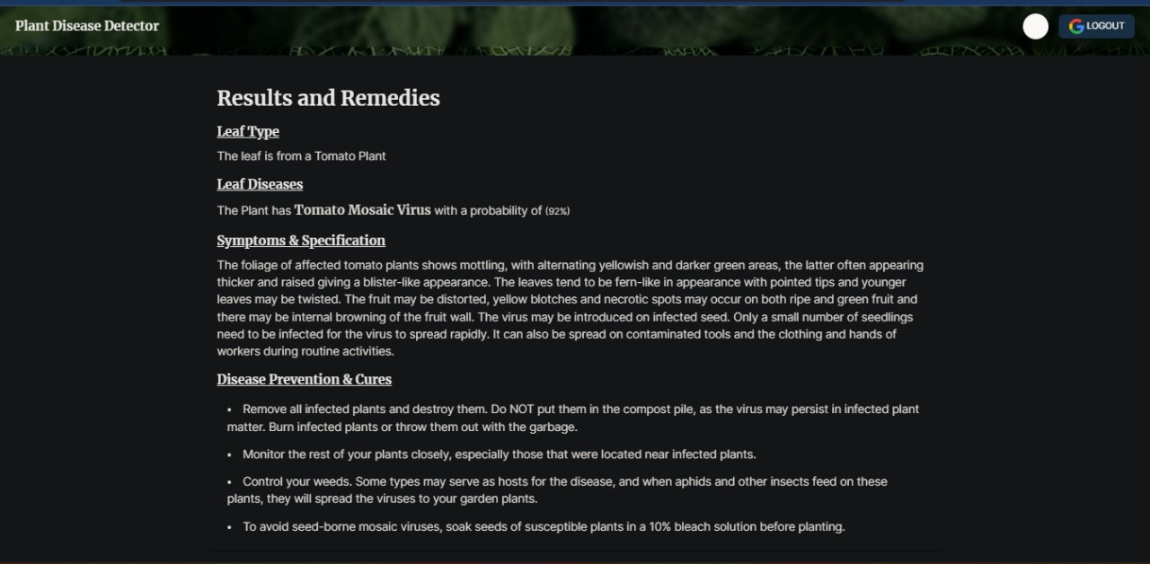
Screenshots (contd.)

Slide 16
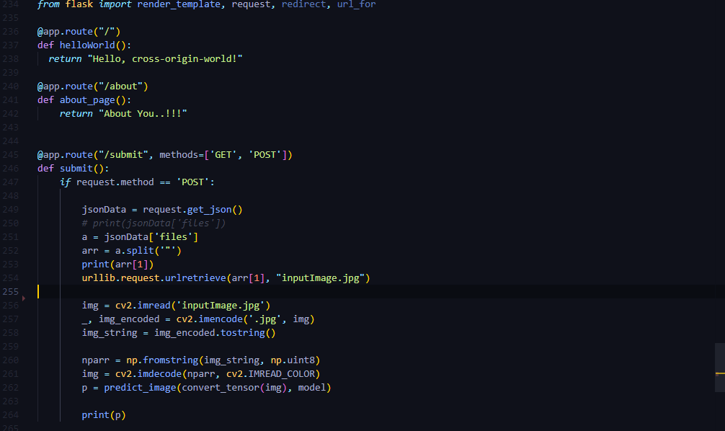
Screenshots (contd.)

Slide 17
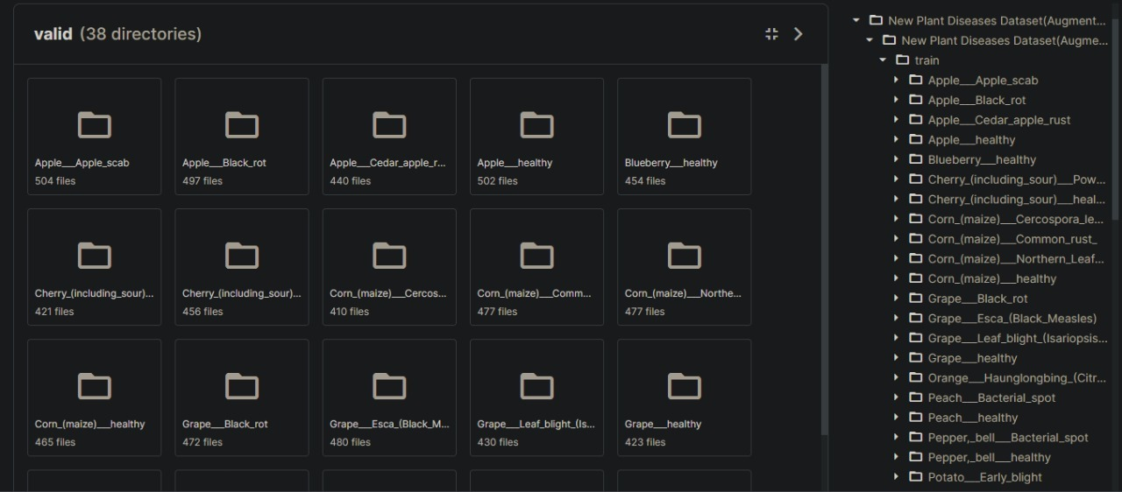
Screenshots (contd.)

Slide 18
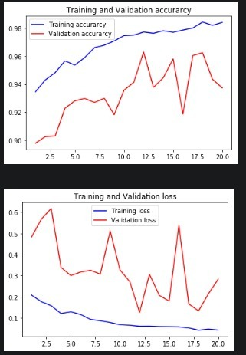
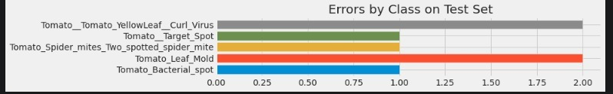
Screenshots (contd.)

Slide 19
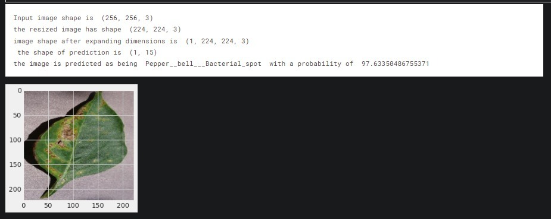
Screenshots (contd.)

Slide 20
Screenshots (contd.)

Slide 21
Tool Description
Design software – Figma
Kaggle
Google Collab
IDE - VSCode
Frontend framework- React
Libraries – Redux, React router, Material UI, Firebase, React-google-login, keras, tensorflow. Matplotlib, cv2, sklearn
Database- Firebase firestore

Slide 22
Future Plans
In the future we will focus on gathering images for enriching the database and improving accuracy of the model using different techniques of fine-tuning and augmentation
In addition, we will include expanding the model's use by training it for plant disease recognition on larger land areas, merging aerial photographs of orchards and vineyards obtained by drones with object detection using convolution neural networks. We hope that by expanding this study, they will be able to have a positive influence on long-term development and crop quality for future generations.

Slide 23
References
R. Balodi, S. Bisht, A. Ghatak, and K. H. Rao, “Plant disease diagnosis: Technological advancements and challenges,” Indian Phytopathology, vol. 70, no. 3, pp. 275–281, 2017.
F. Martinelli, R. Scalenghe, S. Davino et al., “Advanced methods of plant disease detection. A review,” Agronomy for Sustainable Development, vol. 35, no. 1, pp. 1–25, 2015.
J. S. West, C. Bravo, R. Oberti, D. Lemaire, D. Moshou, and H. A. McCartney, “The potential of optical canopy measurement for targeted control of field crop diseases,” Annual Review of Phytopathology, vol. 41, pp. 593–614, 2003.
A. Singh, B. Ganapathysubramanian, A. K. Singh, and S. Sarkar, “Machine learning for high-throughput stress phenotyping in plants,” Trends in Plant Science, vol. 21, no. 2, pp. 110–124, 2016.
A. Johannes, A. Picon, A. Alvarez-Gila et al., “Automatic plant disease diagnosis using mobile capture devices, applied on a wheat use case,” Computers and Electronics in Agriculture, vol. 138, pp. 200–209, 2017.
S. P. Mohanty, D. P. Hughes, and M. Salathé, “Using deep learning for image-based plant disease detection,” Frontiers in Plant Science, vol. 7, p. 1419, 2016.
J. Amara, B. Bouaziz, and A. Algergawy, “A deep learning-based approach for banana leaf diseases classification,” in Proceedings of the Datenbanksysteme für Business, Technologie und Web (BTW '17) - Workshopband, 2017.
K. P. Ferentinos, “Deep learning models for plant disease detection and diagnosis,” Computers and Electronics in Agriculture, vol. 145, pp. 311–318, 2018.
S. Sladojevic, M. Arsenovic, A. Anderla, D. Culibrk, and D. Stefanovic, “Deep neural networks based recognition of plant diseases by leaf image classification,” Computational Intelligence and Neuroscience, vol. 2016, Article ID 3289801, 11 pages, 2016.
G. Wang, Y. Sun, and J. Wang, “Automatic image-based plant disease severity estimation using deep learning,” Computational Intelligence and Neuroscience, vol. 2017, Article ID 2917536, 8 pages, 2017.

Slide 24
Thank you

